Slide 1

DVS Core
Dan Violet Sagmiller, Core Utilities
(Version records and history)
License CC-BY 2.0 (Attribution)

Slide 2
Key Features
Easy to Setup & Use
Set & Forget UI Version
History is Code-Accessible
Support Past Code
Easy Reporting to managers/team on status
Tracking Who, What, When (start/finish).

Slide 3
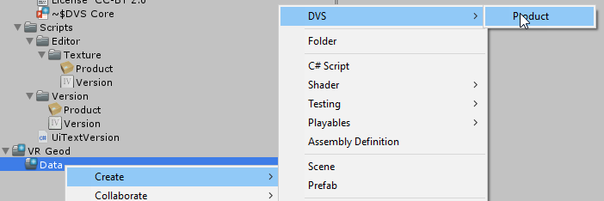

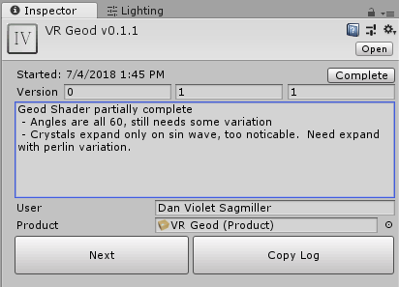
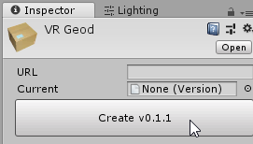
Setup & Use
Create a Product
Name it
Create the first version
Enter Changes
Copy Log then paste formatted message into Collab, Email or Chat
Click Next To produce a new version/v#

Slide 4
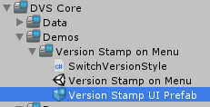

Use Cases: Set & Forget UI
Drag the Version Stamp UI Prefab onto your canvas
Set the product
Now forget it.
Every time you update the version for the product, the UI will show the current version details.
Guarantees client screen shots always show their version.
No more having to manually update a field every push.

Slide 5
Use Cases: History is Code-Accessible
Public Product Product;
Accessor = Product.Current.Previous.Previous…
Null = end;
Access the current version and all version history through code.
Allows easy dynamics for history/update scenes.
Allows easy custom editor code to work with these.

Slide 6
Use Cases: Support Past Code
Store version as part of level saves and use level tags to compare.
Public class Level : MonoBehaviour {
Public Version SaveVersion; // if null at Start(), set from Product.Current
Public class LevelLoader : MonoBehaviour {
Public Level Level;
Public void LoadLevel() {
If (Level.SaveVersion.IsGreaterThan(1, 1, 2) LoadLevel1_1_2();
Else LoadLevelOriginal();
Operators are overloaded.
var isTooOld = version < versionTooOldPoint

Slide 7
Use Cases: Easy Reporting
[Copy Log] generates a formatted change report
Saves to clipboard
Example from Image:
Easily paste to collaborate, email report to manager, or to your blog post.
VR Geod v0.1.1:
7/4/2018 1:45 PM-
Geod Shader partially complete - Angles are all 60, still needs some variation - Crystals expand only on sin wave, too noticable. Need expand with perlin variation.

Slide 8
Contact
Author, Dan Violet Sagmiller
Email: Game.Dev@Live.com
LinkedIn: http://bit.ly/DVS-Profile
RTS Unity Course: http://www.lynda.com/Unity-tutorials/Welcome/427923/479691-4.html
Unity AI Book: https://www.packtpub.com/game-development/unity-ai-programming-essentials
Unite SOLID Video: https://www.youtube.com/watch?v=eIf3-aDTOOA
MS MVP: https://mvp.microsoft.com/en-us/PublicProfile/5002095
Feel free to reach out to me for Questions & Suggestions
License CC-BY 2.0 (Attribution)

